Slide 1

Clustering the American Electorate
James Olmstead

Slide 2
Table of Contents
Introduction
Data Cleaning
Exploratory Analysis
In-depth Analysis
Conclusion

Slide 3
Introduction
Can we use clustering algorithms to better understand the American electorate?
Data is from Democracy Fund (https://www.voterstudygroup.org/publication/2018-voter-survey-1)
Survey about political beliefs, attitudes, and demographic information
Longitudinal study from 2011 (pre-election) to 2018

Slide 4
Data Cleaning
Problems:
Missing Values
Different start times for respondents
Blank responses
Inconsistent Data Types
Text Data (State of Residence)
Ordinal Data (How Liberal are you on 1-10 scale)
Numerical Data (Income)
Categorical Data (Yes/No)
More than 1,000 Questions!
Irrelevant/redundant questions
Questions mostly unanswered
Solutions
Missing Values
Removed respondents who didn’t participate each year
Combined blanks with “Don’t Know’ responses
Inconsistent Data Types
Removed or converted to categorical
Re-classified as categorical
Built buckets to convert to categorical
Unchanged, since we want everything to be categorical
More than 1,000 Questions!
Removed irrelevant/redundant questions
Removed mostly unanswered questions
(NEW) Created sections of questions for easier analysis

Slide 5
Initial Analysis
1. How are the responses correlated?
2. Which political issues are priorities for the survey respondents?
3. Where do the respondents stand on the major party platforms?
Only a small subset of potential questions to ask

Slide 6
Initial Analysis
1. How are the responses correlated?
Created a correlation matrix for each question in the survey (excerpt below)
Examined which questions in the correlation matrix frequently had high correlations with the other questions
Col_name | vote18_2018 | trumpapp_2018 | trumpfeel_2018 | fav_trump_2018 | fav_ryan_2018 | fav_obama_2018 | fav_hrc_2018 | fav_sanders_2018
vote18_2018 | 1 | 0.450280763 | 0.400818175 | 0.439771463 | 0.320679755 | 0.450419237 | 0.420228674 | 0.37139194
trumpapp_2018 | 0.450280763 | 1 | 0.557278251 | 0.660949895 | 0.330210261 | 0.455726316 | 0.405711997 | 0.359251281
trumpfeel_2018 | 0.400818175 | 0.557278251 | 1 | 0.574585472 | 0.317796272 | 0.451211456 | 0.413587009 | 0.368548182
fav_trump_2018 | 0.439771463 | 0.660949895 | 0.574585472 | 1 | 0.34602991 | 0.502098643 | 0.443832373 | 0.37991684
fav_ryan_2018 | 0.320679755 | 0.330210261 | 0.317796272 | 0.34602991 | 1 | 0.31589553 | 0.282110878 | 0.310819214
fav_obama_2018 | 0.450419237 | 0.455726316 | 0.451211456 | 0.502098643 | 0.31589553 | 1 | 0.511835667 | 0.430855983
fav_hrc_2018 | 0.420228674 | 0.405711997 | 0.413587009 | 0.443832373 | 0.282110878 | 0.511835667 | 1 | 0.391879402

Slide 7
Initial Analysis
Top 10 Highly Correlated Questions
1. selfdescr_ccap_7_baseline: Self-identify (or not) as a Conservative
2. selfdescr_ccap_9_baseline: Self-identify (or not) as a Progressive
3. dailytalkshow_1_baseline: Watch the FOX O'Reiley Factor on a regular basis (or not)
4. selfdescr_ccap_5_baseline: Self-identify (or not) as a Liberal
5. enews_show_4_baseline: Watch FOX Special Report with Bret Baier on a regular basis (or not)
6. healthreformbill_2017: Do you think the health care reform bill that passed in 2010 should be expanded, kept the same, or repealed?
7. dailytalkshow_2_baseline: Watch FOX Hannity on a regular basis (or not)
8. redovote2016_2017: If you had the chance to do it again, how would you vote in 2016? (Choices Trump, Clinton, or someone else)
9. Clinton_Cruz_2016: If the 2016 election had been a race between Clinton and Cruz, who would you vote for?
10. teapartsup_baseline: Generally speaking, do you support or oppose the goals of the Tea Party movement?

Slide 8
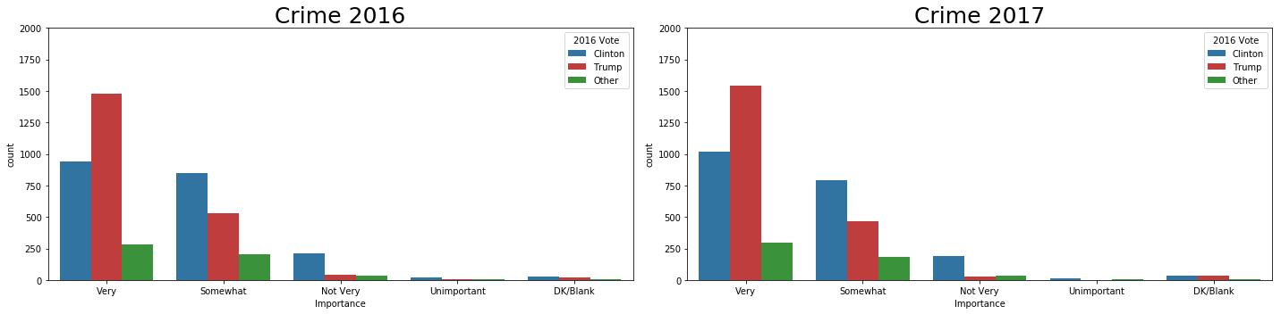
Initial Analysis
2. Which political issues are priorities for the survey respondents?
Looked at set of 23 questions for 2016 and 2017 that asked about the importance of certain political issues
One question (Crime) is below:

Slide 9
Initial Analysis
Clinton Voters Rating “Very Important”
Trump Voters Rating “Very Important”
Health Care_2016 1714
Social Security_2016 1600
Medicare_2016 1530
The Enviroment_2016 1476
Education_2016 1466
The Economy_2016 1461
Climate Change_2016 1421
Jobs_2016 1358
Poverty_2016 1350
Racial Equality_2016 1278
The Economy_2016 1777
Terrorism_2016 1716
Jobs_2016 1634
The Budget Deficit_2016 1527
Taxes_2016 1492
Crime_2016 1480
The Size of Government_2016 1444
Social Security_2016 1426
Immigration_2016 1393
Health Care_2016 1385

Slide 10
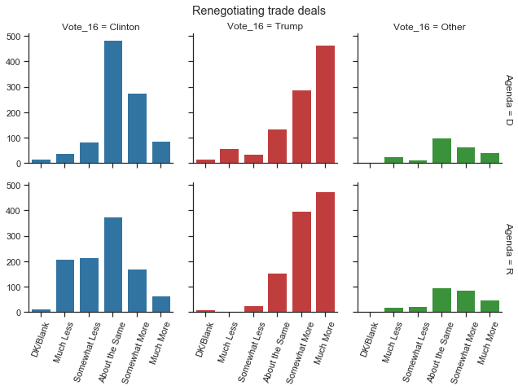
Initial Analysis
3. Where do the respondents stand on the major party platforms?
How do respondents feel about how each party is addressing major issues?
How does it differ between Trump and Clinton voters?

Slide 11
In-Depth Analysis
The Process:
Dimensionality Reduction
K-means algorithm
Examination of clusters

Slide 12
Dimensionality Reduction
Multiple Component Analysis (MCA)
Performed on each section of survey questions
Allows for more interpretable components and conversion from categorical to continuous variables

Slide 13
Creating the Clusters
K-means algorithm on newly created components (k=9)
Clusters given names based on which questions were largest factors influencing a given cluster

Slide 14
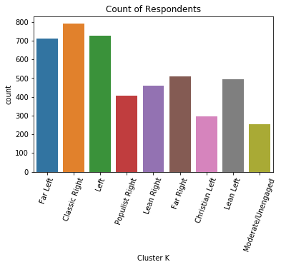
Interpreting the Clusters
0. Moderate/Unengaged: Don't follow political news closely and don’t z have strong political opinions
Lean Left: Mainly have moderate views, but lean towards the political left in most respects.
Populist Right: Hold strict views on immigration and are distrustful towards large institutions.
Christian Left: Hold mostly mainstream views of political left, but are more likely to be African-American and Christian
Lean Right: Mainly have moderate views, but lean towards the political right in most respects.
Far Left: Hold views well to the left of most respondents.
Far Right: Hold views well to the right of most respondents.
Left: Hold views to the left of most respondents, but not as extreme as the Far Left.
Classic Right: Hold views to the right of most respondents, but are more open to immigration and free-markets than the Populist Right.

Slide 15
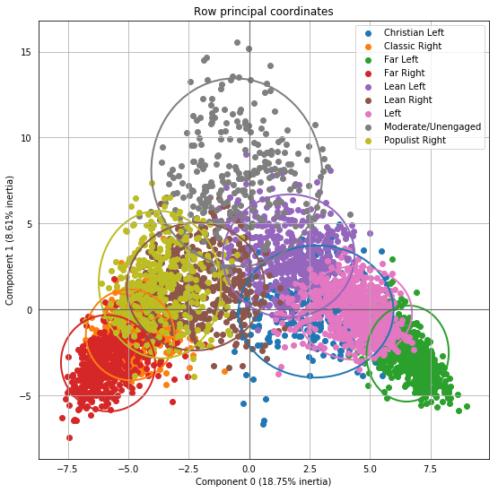
Visualizing the Clusters in 2-D
Extreme/Engaged
Moderate/Disengaged
Political Right
Political Left

Slide 16
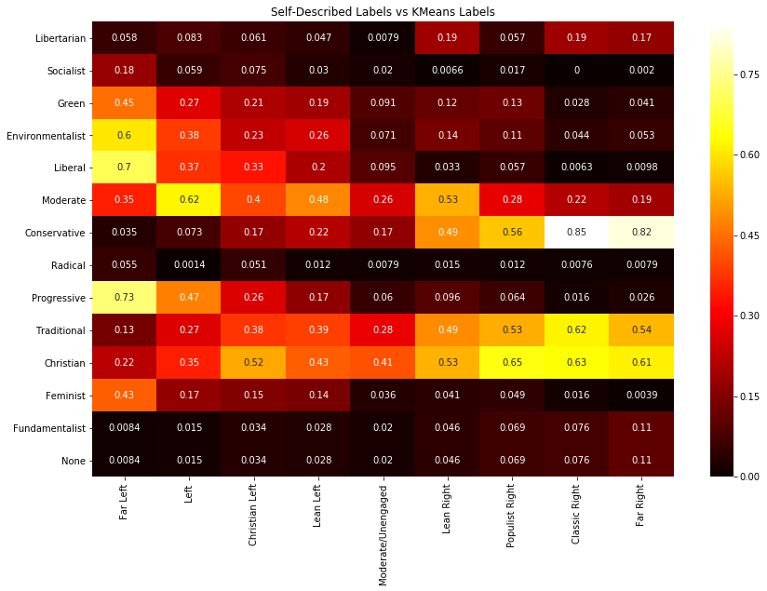
Self-Identification of Clusters
Percentage of cluster that answered that they identify as a given label
For example, 61% of ‘Far Right’ cluster identified as ‘Christian’ in the survey

Slide 17
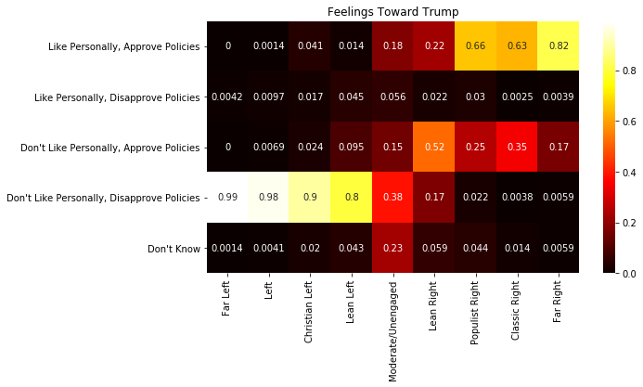
Feelings Toward President Trump
Breakdown of the survey question “trumpfeel_2018”

Slide 18
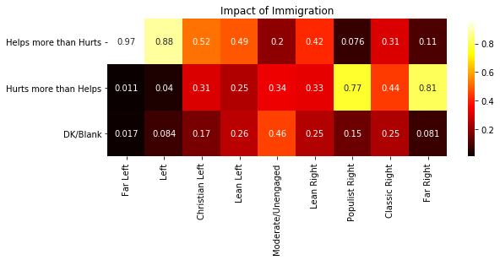
Impact of Immigration
Breakdown of the survey question “immigration_help_2017”

Slide 19
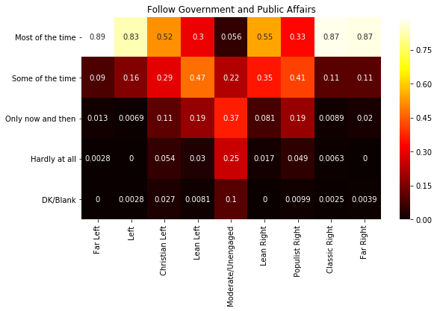
Extent of following political news
Breakdown of the survey question “newsint_2018”

Slide 20
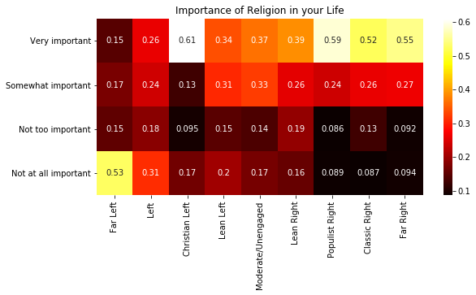
Importance of Religion
Breakdown of the survey question “pew_religimp_2018”

Slide 21
Conclusion and Future
Overall pleased with how the clusters turned out
Lots more room for exploration
Could try different clustering algorithms
Could try smaller sections for more efficient MCA

